Slide 1
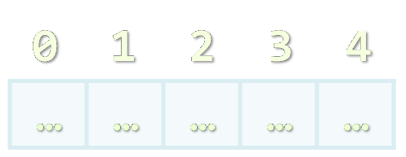

Arrays
Processing Sequences of Elements
JavaScript Fundamentals
Telerik Software Academy
http://academy.telerik.com

Slide 2

Table of Contents
Declaring and Creating Arrays
Accessing Array Elements
Processing Array Elements
Dynamic Arrays
Operations with arrays:
Concatenation
Slicing
Manipulation

Slide 3


Declaring and Creating Arrays

Slide 4
What are Arrays?
An array is a sequence of elements
The order of the elements is fixed
Does not have fixed size
Can get the current length (Array.length)
Element of an array
0 1 2 3 4
Element index
Array of 5 elements
… | … | … | … | …

Slide 5
Declaring Arrays
Declaring an array in JavaScript (JS is typeless)
// Array holding integers
var numbers = [1, 2, 3, 4, 5];
// Array holding strings
var weekDays = ['Monday', 'Tuesday', 'Wednesday',
'Thursday', 'Friday', 'Saturday', 'Sunday']
// Array of different types
var mixedArr = [1, new Date(), 'hello'];
// Array of arrays (matrix)
var matrix = [
['0,0', '0,1', '0,2'],
['1,0', '1,1', '1,2'],
['2,0', '2,1', '2,2']];

Slide 6

Declare and Initialize Arrays
Initializing an array in JavaScript can be done in three ways:
Using new Array(elements):
Using new Array(initialLength):
Using array literal (recommended):
var arr = new Array(1, 2, 3, 4, 5);
var arr = new Array(10);
var arr = [1, 2, 3, 4, 5];

Slide 7



Creating Arrays
Live Demo

Slide 8

Accessing Array Elements
Read and Modify Elements by Index

Slide 9
How to Access Array Element?
Array elements are accessed using the square brackets operator [] (indexer)
Array indexer takes element’s index as parameter in the range 0 … length-1
The first element has index 0
The last element has index length-1
Array elements can be retrieved and changed by the [] operator

Slide 10
Reversing an Array – Example
Reversing the elements of an array
//always declare variables on the top of the scope!
var array, len, reversed, i;
array = [1, 2, 3, 4, 5];
reversed = [];
for (i = 0, len = array.length; i < len; i += 1) {
reversed.push(array[length – i – 1]);
}

Slide 11
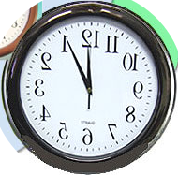


Reversing an Array
Live Demo

Slide 12
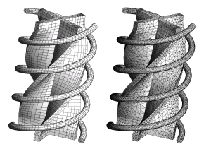
Processing Array Elements Using for and for-in

Slide 13
Processing Arrays: for Statement
Use for loop to process an array when you need to keep track of the index
In the loop body use the element at the loop index (array[index]):
var i, len;
for (i = 0, len = array.length; i < len; i += 1) {
squares[i] = array[i] * array[i];
}

Slide 14
Processing Arrays Using for Loop – Examples
Printing array of numbers in reversed order:
Initialize all array elements with their corresponding index number:
var arr, i, len;
arr = [1, 2, 3, 4, 5];
for (len = arr.length, i = len - 1; i >= 0; i -= 1) {
console.log(arr[i]);
}
// Result: 5 4 3 2 1
var i, len
for (i = 0, len = array.length; i < len; i += 1) {
array[i] = i;
}

Slide 15

Processing Arrays: for-in
How for-in loop works?
index iterates through the indexes of the array
Used when the indexes are unknown
All elements are accessed one by one
Order is not guaranteed
var index;
for (index in array)

Slide 16
Example: Processing Arrays Using for-in Loop
Print all elements of an array of strings:
var capitals, i;
capitals = [
'Sofia',
'Washington',
'London',
'Paris'
];
for (i in capitals) {
console.log(capitals[i]);
}

Slide 17
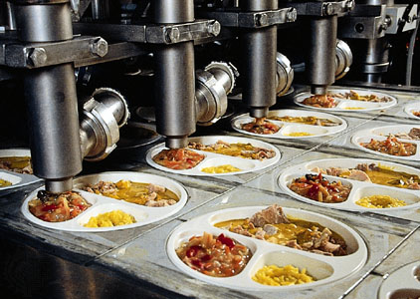
Processing Arrays
Live Demo

Slide 18
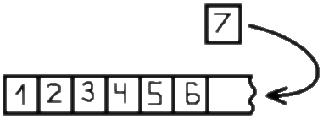


Dynamic Arrays

Slide 19
Dynamic Arrays
All arrays in JavaScript are dynamic
Their size can be changed at runtime
New elements can be inserted to the array
Elements can be removed from the array
Methods for array manipulation:
[].push(element)
Inserts a new element at the tail of the array
[].pop()
Removes the element at the tail
Returns the removed element

Slide 20
Dynamic Arrays (2)
Methods for array manipulation (cont.)
[].unshift(element)
Inserts a new element at the head of the array
[].shift()
Removes and returns the element at the head
var numbers, tail, head;
numbers = [1, 2, 3, 4, 5];
console.log(numbers.join(', ')); // result: 1, 2, 3, 4, 5
tail = number.pop(); // tail = 5;
console.log(numbers.join(', ')); // result: 1, 2, 3, 4
number.unshift(0);
console.log(numbers.join(', ')); // result: 0, 1, 2, 3, 4
head = number.shift(); // head = 0;
console.log(numbers.join(', ')); // result: 1|2|3|4

Slide 21
Dynamic Arrays
Live Demo

Slide 22
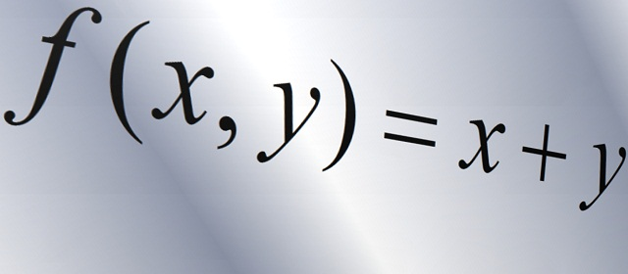
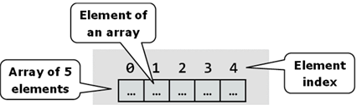
Array Methods

Slide 23
[].reverse() and [].join()
[].reverse() method
Returns a new arrays with elements in reversed order
[].join(separator) method
Concatenates the elements of the array with a provided separator (by default none)
Returns a string
var numbers, reversed, result;
numbers = ['One', 'Two', 'Three'];
reversed = numbers.reverse();
result = reversed.join(', ');
console.log(result); //prints 'Three, Two, One'
result = reversed.join(' then ');
console.log(result); //prints 'Three then Two then One'

Slide 24
[].reverse() and [].join()
Live Demo

Slide 25
Concatenating Arrays
arr1.concat(arr2)
Inserts the elements of arr2 at the end of arr1 and returns a new array
arr1 and arr2 remain unchanged!
var arr1, arr2, concatenated;
arr1 = [1, 2, 3];
arr2 = ['One', 'Two', 'Three'];
concatenated = arr1.concat(arr2);
console.log(arr1);
console.log(arr2);
console.log(concatenated);
[1, 2, 3]
['One', 'Two', 'Three']
[1, 2, 3, 'One', 'Two', 'Three']
Result:

Slide 26
Concatenating Arrays
Live Demo

Slide 27
Slicing Arrays
[].slice(from [, to])
Returns a new array that is a shallow copy of a portion of the array
The new array contains the elements from indices from to to (excluding to)
Can be used to clone an array
var arr, portion, copy;
arr = [1, 2, 3, 4, 5];
portion = arr.slice(3, 6);
copy = arr.slice(0) //arr.slice()
console.log(arr);
console.log(portion);
console.log(copy);
Result:
[ 1, 2, 3, 4, 5 ]
[ 4, 5 ]
[ 1, 2, 3, 4, 5 ]

Slide 28
Slicing Arrays
Live Demo

Slide 29
Manipulating Arrays: [].splice()
[].splice(index, count, elements)
Adds and removes elements from an array at the given position
var arr = [1, 2, 3, 4, 5, 6], p = 3, c = 2;
//remove c elements at position p
arr.splice(p, c);
console.log(arr);
//insert 'four', 'five', 'extra' at position p
arr.splice(p, 0, 'four', 'five', 'extra');
console.log(arr);
//remove c elements at position p
//and insert 'x', 'y' and 'z' at the same position
arr.splice(p, c, 'x', 'y', 'z');
console.log(arr);
//prints [ 1, 2, 3, 6 ]
//prints [ 1, 2, 3, 'four', 'five', 'extra', 6 ]
//prints [ 1, 2, 3, 'x', 'y', 'z', 'extra', 6 ]

Slide 30
Manipulating Arrays: [].splice()
Live Demo

Slide 31
Other Array Functions (2)
[].indexOf(element [, rightOf])
Returns the index of the first match in the array
Returns -1 is the element is not found
[].lastIndexOf(element, [leftOf])
Returns the index of the first match in the array
Returns -1 is the element is not found
indexOf() and lastIndexOf() do not work in all browsers
Need to be shimmed

Slide 32
[].indexOf() and [].lastIndexOf()
Live Demo

Slide 33
Other Arrays Functions
Arrays official documentation:
https://developer.mozilla.org/en-US/docs/Web/JavaScript/Reference/Global_Objects/Array
Checking for array
typeof([1, 2, 3]) → object
Not working
Array.isArray([1, 2, 3]) → true
Supported on all modern browsers

Slide 34

Arrays
http://academy.telerik.com

Slide 35




Free Trainings @ Telerik Academy
"Web Design with HTML 5, CSS 3 and JavaScript" course @ Telerik Academy
html5course.telerik.com
Telerik Software Academy
academy.telerik.com
Telerik Academy @ Facebook
facebook.com/TelerikAcademy
Telerik Software Academy Forums
forums.academy.telerik.com

